Slide 1
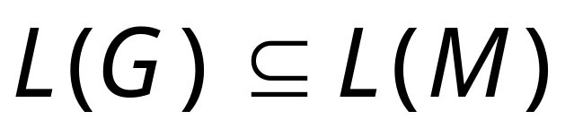
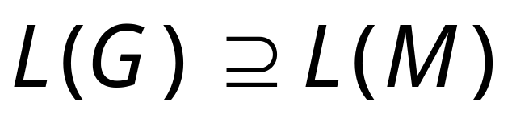
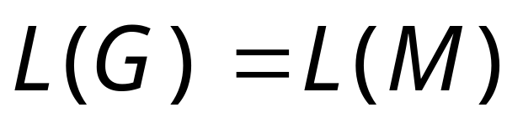
So far we have shown:
With a similar proof we can show
Therefore:
Courtesy Costas Busch - RPI

Slide 2
Properties of
Context-Free languages

Slide 3
Positive Closure for CFL

Slide 4



Union
Context-free languages
are closed under:
Union
is context free
is context free
is context-free
Courtesy Costas Busch - RPI

Slide 5
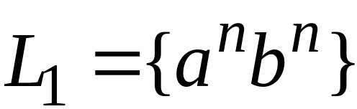
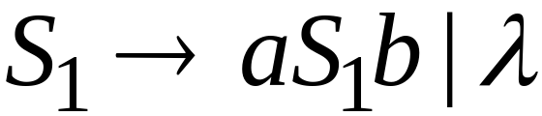
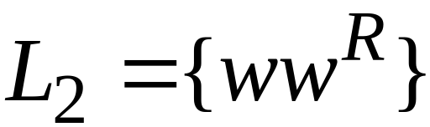
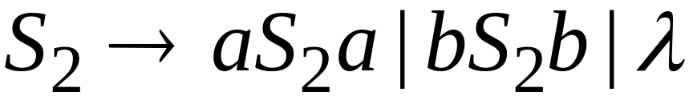
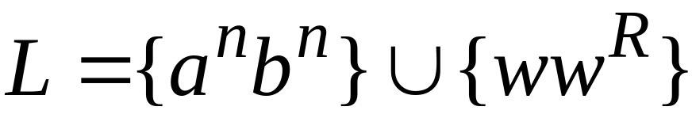

Example
Language
Grammar
Union
Courtesy Costas Busch - RPI

Slide 6
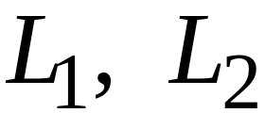
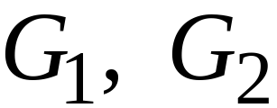
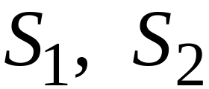

In general:
For context-free languages
with context-free grammars
and start variables
The grammar of the union
has new start variable
and additional production
Courtesy Costas Busch - RPI

Slide 7

Concatenation
Context-free languages
are closed under:
Concatenation
is context free
is context free
is context-free
Courtesy Costas Busch - RPI

Slide 8
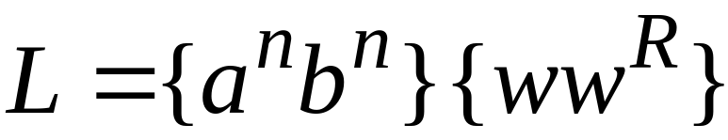
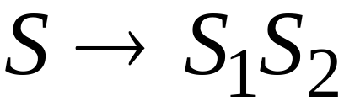
Example
Language
Grammar
Concatenation
Courtesy Costas Busch - RPI

Slide 9
In general:
For context-free languages
with context-free grammars
and start variables
The grammar of the concatenation
has new start variable
and additional production
Courtesy Costas Busch - RPI

Slide 10


Star Operation
Context-free languages
are closed under:
Star-operation
is context free
is context-free
Courtesy Costas Busch - RPI

Slide 11
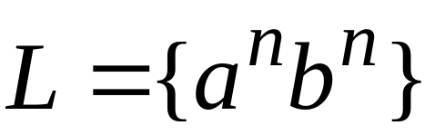
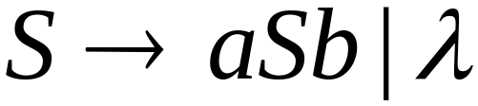
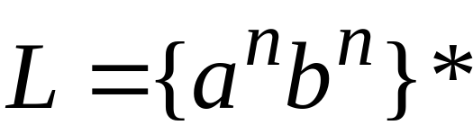
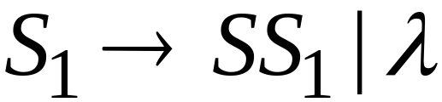
Example
Language
Grammar
Star Operation
Courtesy Costas Busch - RPI

Slide 12



In general:
For context-free language
with context-free grammar
and start variable
The grammar of the star operation
has new start variable
and additional production
Courtesy Costas Busch - RPI

Slide 13
Negative Closure for CFL
Courtesy Costas Busch - RPI

Slide 14

Intersection
Context-free languages
are not closed under:
intersection
is context free
is context free
not necessarily
context-free
Courtesy Costas Busch - RPI

Slide 15
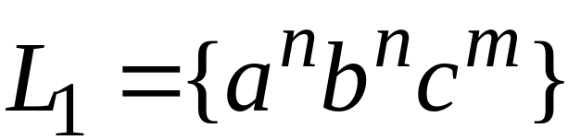
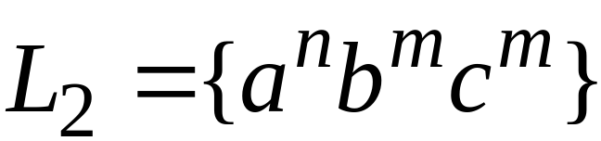
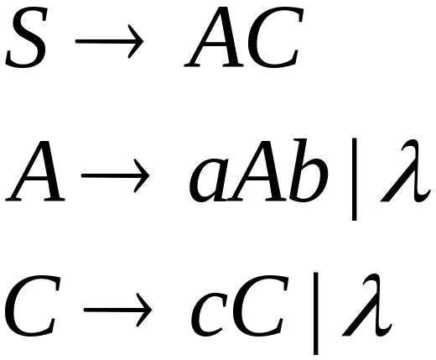
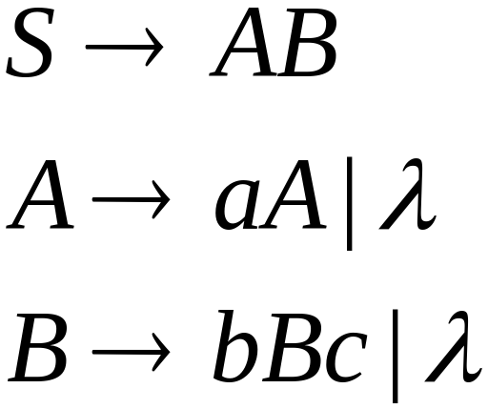
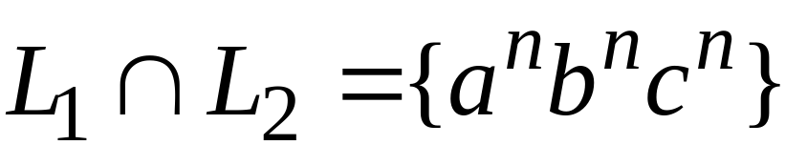
Example
Context-free:
Context-free:
Intersection
NOT context-free
Courtesy Costas Busch - RPI

Slide 16

Complement
Context-free languages
are not closed under:
complement
is context free
not necessarily
context-free
Courtesy Costas Busch - RPI

Slide 17
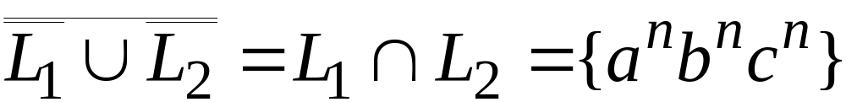
Example
Context-free:
Context-free:
Complement
NOT context-free
Courtesy Costas Busch - RPI

Slide 18
Intersection of
Context-free languages and
Regular Languages
Courtesy Costas Busch - RPI

Slide 19
The intersection of
a context-free language and
a regular language
is a context-free language
context free
regular
context-free
Courtesy Costas Busch - RPI

Slide 20

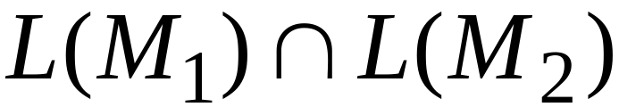
Therefore:
is PDA
is context-free
is context-free
Courtesy Costas Busch - RPI

Slide 21
The intersection of
a context-free language and
a regular language
is a context-free language
Regular Closure
context free
regular
context-free
Courtesy Costas Busch - RPI

